Slide 1
Integrated Accident Detection & Response System
17 • 02 • 2022

Slide 2
This Is Our Team
Parth Shah
Rutuja Shelar
Jay Patel
Omkar Mahadik

Slide 3
1
2
3
4
Contents Table
Hardware Requirements
Problem Statement
Work Flow
Software Requirements

Slide 4

“The greatest loss of life is nothing but a death of the person that is not reached hospital on time!

Slide 5
Problem Statement
1

Slide 6
According to WHO, research says that in the current scenario, 1.3 million people are the victims of road traffic crashes, and 40% of these accidents of all fatal accidents occur at night. In most cases, the accidents are not reported immediately, or the injured doesn’t receive any help during that time. The time between the accident and the arrival of medical help for the injured can sometimes make the difference between his life or death.
So, in this Modern era, everything is being automated and with this project, we are going to automate this process with some electronic components and Arduino, and will help to solve this un-noticed problem and save lives of the people.

Slide 7
Hardware requirements for the system
3

Slide 8
Hardware Requirements
2
Arduino Uno
GPRS Module
Accelerometer
GSM Module
Bread Board
Jumper Wires

Slide 9
Software requirements for the system
4

Slide 10
Software used in the system
3
Proteus 8 Professional
The Proteus Design Suite combines ease of use with a powerful feature set to enable the rapid design, test and layout of professional printed circuit boards.

Slide 11
Workflow for the system
2

Slide 12
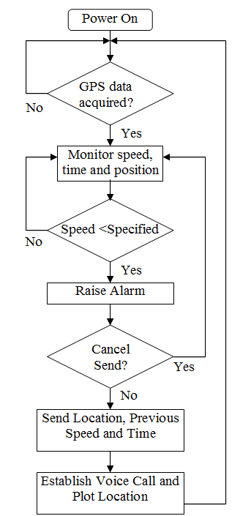
Workflow
4

Slide 13
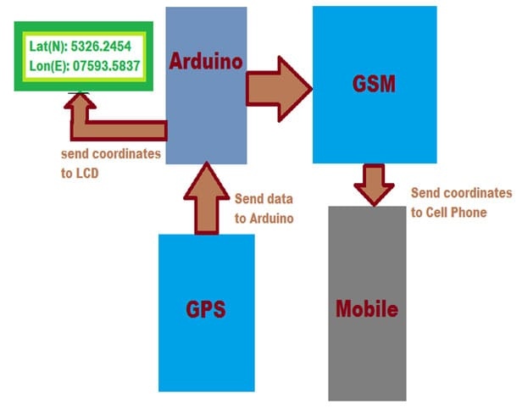
Block Diagram
4

Slide 14
Thanks !
An Small Attempt to Bring Significant Change to this WORLD

